Slide 1
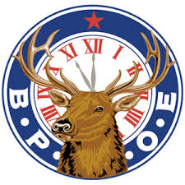
The Calabash Elks
And the
McLean-Rochel Memorial GOLF TOURNAMENT
Proud Supporters of
First Tee

